Slide 1
“Roles and Examples of Social Capital as Protective Determinants of Healthy Aging”
Thomas M. Maestas University of New Mexico

Slide 2
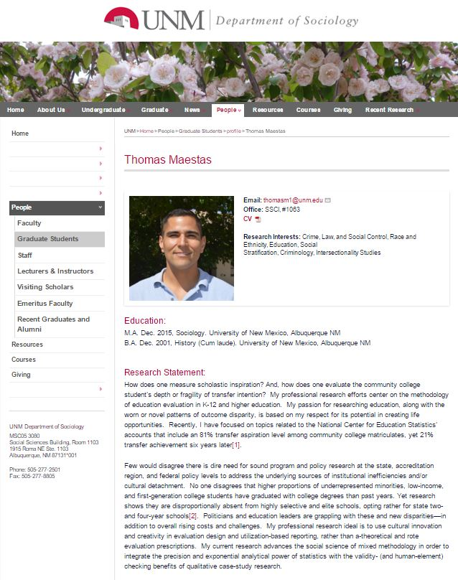


“Roles and Examples of Social Capital as Protective Determinants of Healthy Aging”
First, I'll spend a minute to introduce myself, as both a native New Mexican and also a newly graduated with an MA in December. My relationship with social science and public health. I finished my master's thesis in sociology, titled:
“On the Widening Transfer Aspiration-Achievement Gap: Contextualizing the Transfer Intentions of Community College Students in New Mexico.”

Slide 3
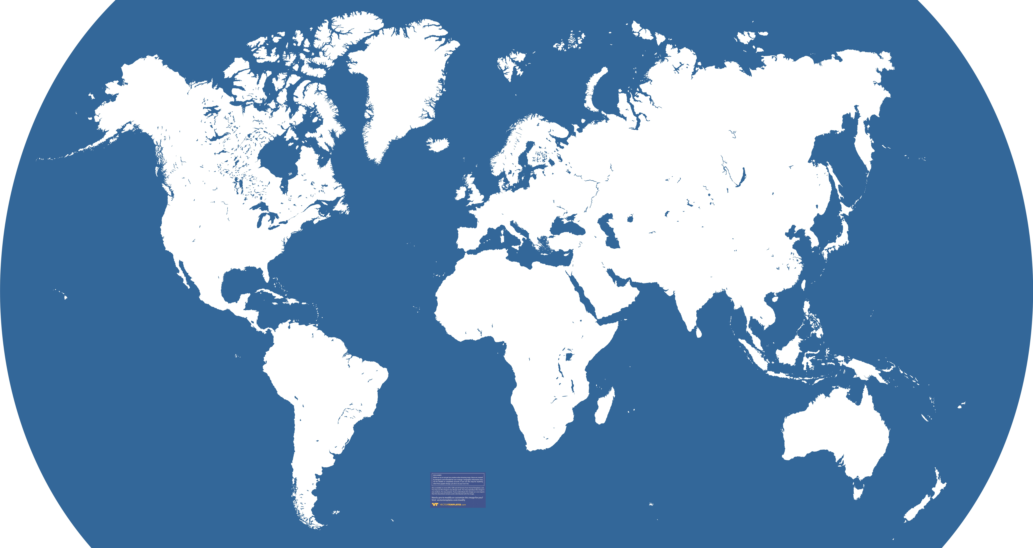
“Roles and Examples of Social Capital as Protective Determinants of Healthy Aging”
The subject I'll be speaking on regards the social determinants that play a role in shaping our lifestyle habits, and in turn our health.
These criteria begin to define what it is we call our social networks.
Norway
China
Japan
Switzerland
U.S.
India
Kenya
Brazil
Australia

Slide 4
“Roles and Examples of Social Capital as Protective Determinants of Healthy Aging”
Social Networks vary in strength, in distance, in symmetry (for example, when trust is not reciprocated). Some of our networks are bunched together, others broaden and partially overlap, some are exclusive and span long-distant resources, and so on.
Norway
China
Japan
Switzerland
U.S.
India
Kenya
Brazil
Australia

Slide 5
Daily social lives and the cultural diversity of social beliefs, norms, and behaviors around aging
So, what role do social networks and the dynamics of daily social lives look like?
Western versus Eastern cultures, and the valuing of individuality versus valuing of community--a vivid set of examples were provided by Dr. Ziarat Hossein's presentation, entitled, “Changing Age Structure and Cultural Perspectives on Aging – Contexts of Family and Care”.

Slide 6
“Roles and Examples of Social Capital as Protective Determinants of Healthy Aging”
Switzerland: Life Expectancy is 83 years old;
Norwegians living 7% longer than 1990.
Kenya 44.3 million—only 4% live past 60.
India is up 14% since 1990.
Australian baby will live to be 83 years old--a 7% increase.
China An increase of 9% to 75.
Japan: third-highest at 84—nearly 27% is over 65
US: Life Expectancy at birth is more than 79 years. Seniors now make up nearly 15% of population (20% by 2030). 10,000 Americans turn 65 every day
Brazil: Life Expectancy now 75 years old (14% rise since 1990)
Norway
China
Japan
Switzerland
U.S.
India
Kenya
CIA World Factbook;
World Health Organization;
Pew Research
Brazil
Australia

Slide 7
“Roles and Examples of Social Capital as Protective Determinants of Healthy Aging”
We tie in these social determinants to health outcomes that vary widely between states in America and between nations across the globe. Within first-world nations by GDP, there is surprising variability. So, why do some nations’ citizens live longer and healthier?
Switzerland: Life Expectancy is 83 years old;
Norwegians living 7% longer than 1990.
Kenya 44.3 million—only 4% live past 60.
India is up 14% since 1990.
Australian baby will live to be 83 years old--a 7% increase.
China An increase of 9% to 75.
Japan: third-highest at 84—nearly 27% is over 65
US: Life Expectancy at birth is more than 79 years. Seniors now make up nearly 15% of population (20% by 2030). 10,000 Americans turn 65 every day
Brazil: Life Expectancy now 75 years old (14% rise since 1990)
Norway
China
Japan
Switzerland
U.S.
India
Kenya
Brazil
CIA World Factbook;
World Health Organization;
Pew Research
Australia

Slide 8
Daily social lives and the cultural diversity of social beliefs, norms, and behaviors around aging
Dr. Hossein spoke about the cultural diversity of social beliefs, norms, and behaviors around aging, and that these cultural beliefs have ramifications for later living arrangements, responsibilities, and so on.
Some of us this Fall learned from Amy Whitfield about the generational differences and conceptions, especially between the digital-native millenials, generation X, the baby boomer generation. And so looking around, there are profound differences along demographic terms around the globe from which each nation shares a common denominator--we as a species are living longer and healthier with new abilities that can be erroneously overlooked.

Slide 9
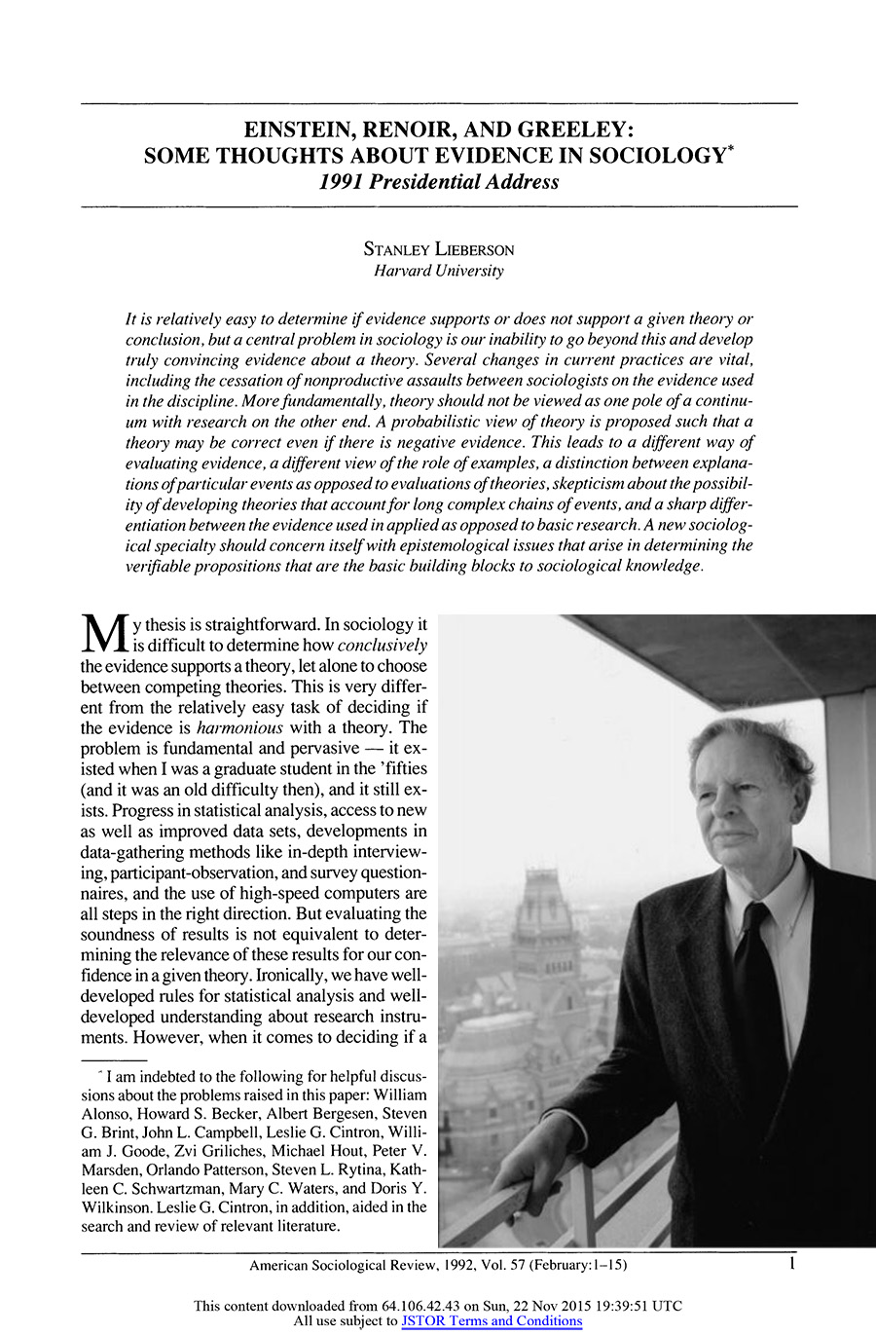
Deterministic Science versus Probabilistic Science
“Roles and Examples of Social Capital as Protective Determinants of Healthy Aging”
. The very first critical step as a scientist is to not overstep the bounds of accepted philosophical tenets of the nature of humans as social beings. Harvard Sociologist Stanley Lieberson, in his 1991 Presidential Address, remarked that social science can capitalize on the power of probabilistic methods when speaking about social determinants--so, we say that certain social conditions of X, Y, and Z, like poverty, social service retrenchment, etc., as specified within our theoretical model, alter the likelihood of differing outcomes.

Slide 10
“Roles and Examples of Social Capital as Protective Determinants of Healthy Aging”
Deterministic Science versus Probabilistic Science
So, how might we interpret the patterns of our social relations? In scientific terms we say that we make an empirical generalization into a theoretical model with which we deduce two or three hypotheses about an observed or experimental evidence.
Evidence, whether supportive or negative evidence, is rare that we gain very reliable knowledge. The exception is through use of frequent, small observations that over time accumulate to practice-based, policy-ready social science.

Slide 11

2 a priori assumptions about human nature: That we are social beings and we are laboring beings.
“Roles and Examples of Social Capital as Protective Determinants of Healthy Aging”
I therefore ask two a priori assumptions about human nature: That we are social beings and we are laboring beings. These two are inextricably linked together in our society in America and abroad:
Between the 20’s and retirement, the first syllables uttered when meeting a new person—after of course the exchange of names—is one’s professional title. Thus one links their identity to the specific domain of professional activities.

Slide 12
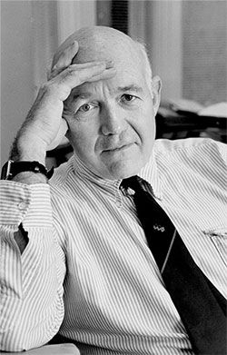
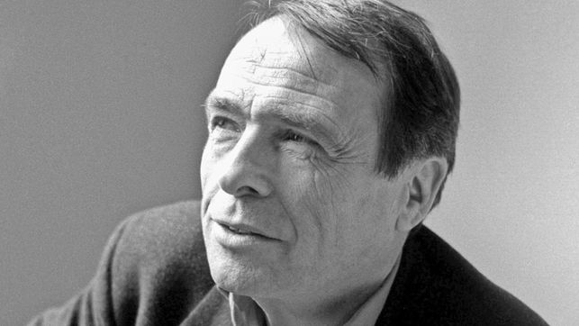
“Roles and Examples of Social Capital as Protective Determinants of Healthy Aging”
James Coleman, American, influential Education-related policy and theory contributions during 1980’s (some of which were not most popular, such as introduction of bussing. Coined popular usage of term, “Social Capital”, outlining 3 primary elements of social capital that are exchanged in social networks:
1. Trust & Reciprocity,
2. Norms & Expectations
3. Information Channels
Pierre Bourdieu, 1980’s Public Sociologist, from Paris
Known for term, “Cultural Capital” and other forms of symbolic forms of social wealth and power that are reducible to economic terms, yet qualitatively separate from any currency or other financial value (at least legally)

Slide 13
“Roles and Examples of Social Capital as Protective Determinants of Healthy Aging”
James Coleman, American, influential Education-related policy and theory contributions during 1980’s (some of which were not most popular, such as introduction of bussing. Coined popular usage of term, “Social Capital”, outlining 3 primary elements of social capital that are exchanged in social networks:
1. Trust & Reciprocity,
2. Norms & Expectations
3. Information Channels
Pierre Bourdieu, 1980’s Public Sociologist, from Paris
Known for term, “Cultural Capital” and other forms of symbolic forms of social wealth and power that are reducible to economic terms.
Other forms of the “Capital-based” model links economic capital to cultural capital and social capital to track and measure the unspoken, implicit—and yet impactful to our lives— social dynamics operate and help define social dynamics.

Slide 14

“Roles and Examples of Social Capital as Protective Determinants of Healthy Aging”
Common Observation all around us, popularized by the book, Bowling Alone: The Collapse and Revival of American Community (2000),
Robert Putnam identified seven dimensions of social capital:
Political participation
Civic participation
Religious participation
Workplace networks
Informal networks
Mutual trust
Altruism

Slide 15
“Roles and Examples of Social Capital as Protective Determinants of Healthy Aging”
Putnam argues there are two distinct, though not necessarily mutually exclusive, types of social capital:
Bridging social capital (inclusive, outward-looking social networks
Bonding social capital (exclusive, inward-looking social networks). In addition Putnam explored changes in social capital over the 20th century, demonstrating that social capital increased between 1900 and the 1960s, then decreased dramatically as a result of pressures of time and money, mobility and sprawl, television, and generational differences.

Slide 16
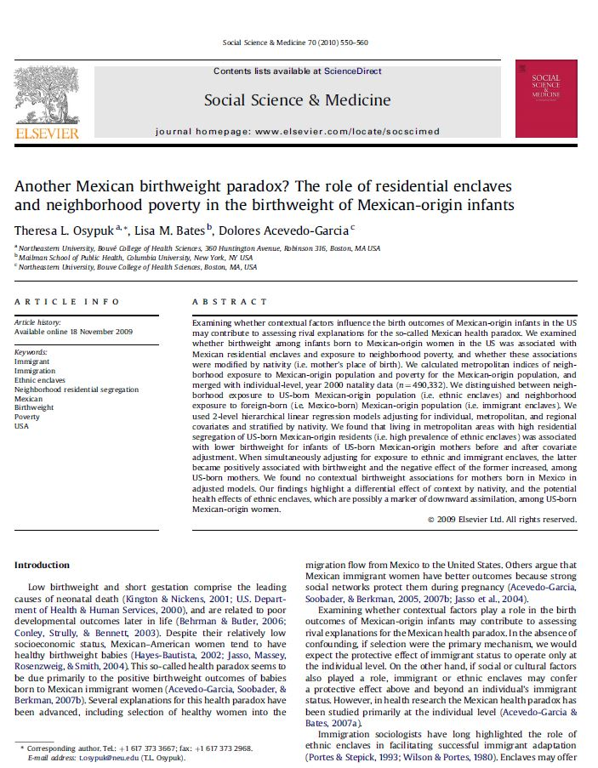
Social capital and social networks
“Roles and Examples of Social Capital as Protective Determinants of Healthy Aging”
Example of Ethnic Enclaves of community-minded networking and disproportionately healthy birthrates. Theresa Osypuk, Linda Bates, and Dolores Acevedo-Garcia have written on the birthweight paradox and other specifically identifiable health outcomes that defy usual predictive models.
Latinos had disproportionately healthy outcomes even among low-income families in low-resource neighborhoods.

Slide 17
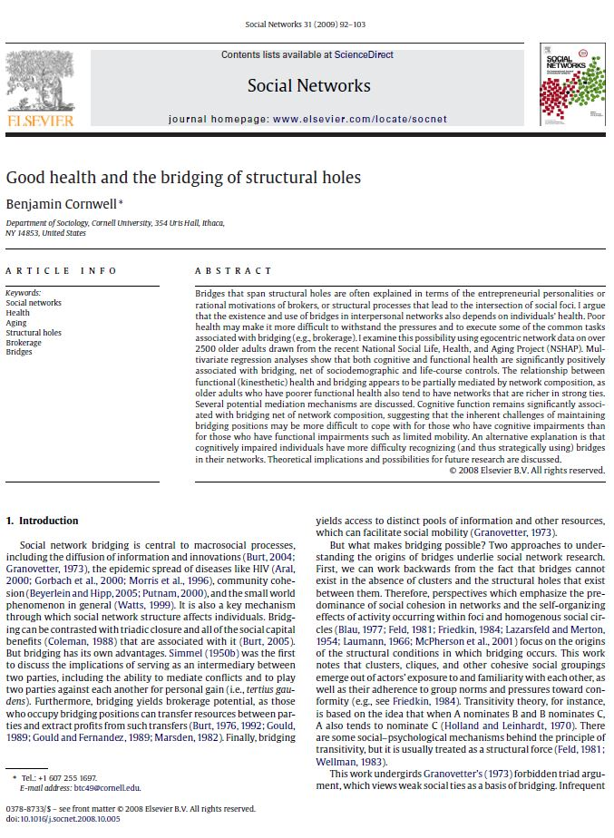
Social network analysis identifies the positive associations with physical and mental health.
“Roles and Examples of Social Capital as Protective Determinants of Healthy Aging”
Example of Benjamin Cornwell’s (2009) data analysis of the National Social Life, Health, and Aging Project (NSHAP). His research revealed these “bridging ties” can be contrasted from triadic friendships.
While social capital is often associated with close, strong ties of mutual trust, reciprocity, and inclusion, [moreso] the social capital of weak, bridging ties are especially helpful in terms of access to new information channels.
Cornwell, B. (2009). Good health and the bridging of structural holes. Social Networks, 31(1), 92–103.

Slide 18

Social capital and social networks
“Roles and Examples of Social Capital as Protective Determinants of Healthy Aging”
Carpiano writes “the conceptual model of neighborhood conditions and social capital—considering relationships between neighborhood social capital forms (social support, social leverage, informal social control, and neighborhood organization participation) and adult health behaviors (smoking, binge drinking) and perceived health, as well as interactions between neighborhood social capital and individuals’ access to that social capital.
Carpiano, R. (2007). Neighborhood social capital and adult health: an empirical test of a Bourdieu-based model. Health & Place.

Slide 19
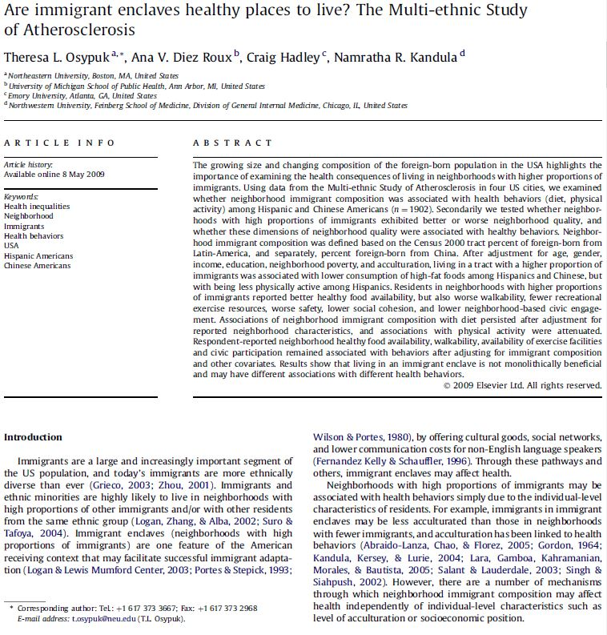
“Roles and Examples of Social Capital as Protective Determinants of Healthy Aging”
Neighborhood conditions and social capital
Critical and changing role of social capital for retirees as their wider “bridging” social ties weaken and “bonding” ties (hopefully) strengthen. The catch is that these bridging, “weak ties” provide critical access to information channels, new forms of trust & reciprocity, resources from social ties and plenty of protective factors. I believe I’ll perhaps discuss either the power of contemporary modeling techniques that capture asymmetry of these ties over time.

Slide 20
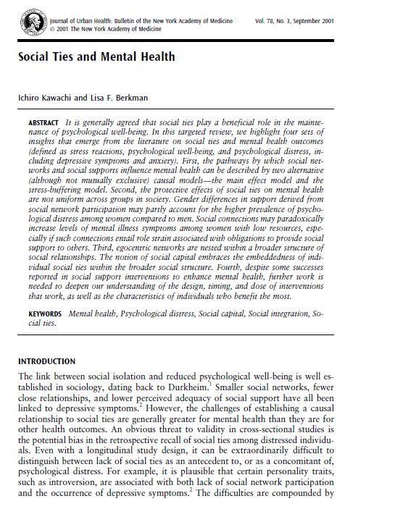
“Roles and Examples of Social Capital as Protective Determinants of Healthy Aging”
“Strength of Weak Ties” and Accessing New forms of Social Capital
Bridging social capital refers to connections between those who are unlike each other yet are ‘more or less equal in other terms of their status and power. The “Strength of Weak Ties” as Mark Granovetter would tell it, is that since “egocentric networks are nested within a broader structure of social relationships. Tapping into this type of social capital embraces resources of the broader social structure” (Kawachi and Berkman, 2001) Thus, individuals can call upon and access resources through their connections to this broader network of social support. Building upon this, the health of the community also flourishes when a greater proportion of its members are actively accessing new resources through their “bridging” ties.
Kawachi, I., & Berkman, L. F. (2001). Social ties and mental health. Journal of Urban Health : Bulletin of the New York Academy of Medicine, 78(3), 458–467.

Slide 21
Social network behavior.
On This information, the mimicry that accompanies close contact, learned techniques of any activity--these are what we can generally call peer influence. Recent literature and advances in social network analysis have closely specified models that measure symmetry, content, structure, and other features that are reducible to quantitative measure and analysis. Social capital indicators from observations, experimental or not, provide the content of analysis when we study social exchanges between individuals (also called nodes) within a network. These exchanges help determine the jobs we find and choose, the food and drinks that we taste and partake, yet they also help us perceive and define "good" nutrition and "moderation". On choices of health, our social lives, our trusted social networks inform us which doctors, which insurance plans, and which pharmaceuticals "work best". Our future outlook on life, and other indicators of good mental health are linked to our social networks, according to research [Lin, Social Networks and Social Capital].

Slide 22
“Roles and Examples of Social Capital as Protective Determinants of Healthy Aging”
References
Abel, T. (2008). Cultural capital and social inequality in health. Journal of Epidemiology and Community Health. Retrieved from http://jech.bmj.com/content/62/7/e13.short
Author, N., & Source, R. T. M. (2014). American Sociological Review, 21(5), 610–613.
Berkman, L. F., Glass, T., Brissette, I., & Seeman, T. E. (2000). From social integration to health: Durkheim in the new millennium. Social Science & Medicine (1982), 51(6), 843–57. Retrieved from http://www.sciencedirect.com/science/article/pii/S0277953600000654\nhttp://www.ncbi.nlm.nih.gov/pubmed/10972429
BibliographyAnnotate_11_9. (n.d.).
Browning, C. R. (2009). Illuminating the Downside of Social Capital: Negotiated Coexistence, Property Crime, and Disorder in Urban Neighborhoods. American Behavioral Scientist, 52, 1556–1578. http://doi.org/10.1177/0002764209331526
Browning, C. R., Soller, B., Gardner, M., & Brooks-Gunn, J. (2013). “Feeling disorder” as a comparative and contingent process: gender, neighborhood conditions, and adolescent mental health. Journal of Health and Social Behavior, 54(3), 296–314. http://doi.org/10.1177/0022146513498510

Slide 23
“Roles and Examples of Social Capital as Protective Determinants of Healthy Aging”
Conclusions
Routine social activities and social intersections help inform our understanding of health, our choices, and the social capital of new information channels. Social Network Analysis in public health planning, education and criminological research literature has made progress in both statistical modeling but also a replicable body of literature that guides the valid science of social research.

Slide 24
“Roles and Examples of Social Capital as Protective Determinants of Healthy Aging”
References
Carpiano, R. (2007). Neighborhood social capital and adult health: an empirical test of a Bourdieu-based model. Health & Place. Retrieved from http://www.sciencedirect.com/science/article/pii/S1353829206000608
Clyde, J. (2012). An Introduction to Sample Selection Bias in Sociological Data Author ( s ): Richard A . Berk Reviewed work ( s ): Source : American Sociological Review , Vol . 48 , No . 3 ( Jun ., 1983 ), pp . 386-398 Published by : American Sociological Association Stab, 48(3), 386–398.
Coleman, J. S. (1988). Social Capital in the Creation of Human Capital. American Journal of Sociology.
Cornwell, B. (2009). Good health and the bridging of structural holes. Social Networks, 31(1), 92–103. http://doi.org/10.1016/j.socnet.2008.10.005
Cornwell, B., & Laumann, E. O. (2011). Network position and sexual dysfunction: implications of partner betweenness for men. AJS; American Journal of Sociology, 117(1), 172–208. http://doi.org/10.1086/661079

Slide 25
“Roles and Examples of Social Capital as Protective Determinants of Healthy Aging”
References
Doyle, W. R. (2011). Effect of increased academic momentum on transfer rates: An application of the generalized propensity score. Economics of Education Review, 30(1), 191–200. http://doi.org/10.1016/j.econedurev.2010.08.004
Ferlander, S. (2007). The importance of different forms of social capital for health. Acta Sociologica. Retrieved from http://asj.sagepub.com/content/50/2/115.short
Gangl, M. (2010). Causal Inference in Sociological Research. Annual Revue of Sociology, 36, 21–47. http://doi.org/10.1146/annurev.soc.012809.102702
González, K. P., Stoner, C., & Jovel, J. E. (2003). Examining the Role of Social Capital in Access to College for Latinas: Toward a College Opportunity Framework. Journal of Hispanic Higher Education, 2(2), 146–170. http://doi.org/10.1177/1538192702250620

Slide 26
“Roles and Examples of Social Capital as Protective Determinants of Healthy Aging”
References
Kawachi, I. (1999). Social capital and community effects on population and individual health. Annals of the New York Academy of Sciences. Retrieved from http://onlinelibrary.wiley.com/doi/10.1111/j.1749-6632.1999.tb08110.x/pdf
Kawachi, I., & Berkman, L. (2000). Social cohesion, social capital, and health. Social Epidemiology. Retrieved from https://books.google.com/books?hl=en&lr=&id=i0qWxy5-X1gC&oi=fnd&pg=PA174&dq=does+internet+increase+social+capital+and+health+outcomes%3F&ots=NIT779sra6&sig=zTpt9yMU529tFtAnpiKQc0XltCc
Kawachi, I., & Berkman, L. F. (2001). Social ties and mental health. Journal of Urban Health : Bulletin of the New York Academy of Medicine, 78(3), 458–467. http://doi.org/10.1093/jurban/78.3.458
Kawachi, I., Kennedy, B. P., & Glass, R. (1999). Social capital and self-rated health: A contextual analysis. American Journal of Public Health, 89, 1187–1193. http://doi.org/10.2105/AJPH.89.8.1187

Slide 27
“Roles and Examples of Social Capital as Protective Determinants of Healthy Aging”
References
Kawachi, I., Kim, D., Coutts, A., & Subramanian, S. V. (2004). Commentary: Reconciling the three accounts of social capital. International Journal of Epidemiology, 33(4), 682–690. http://doi.org/10.1093/ije/dyh177
Lieberson, S. (2014). American Sociological Review,. American Sociological Review, 21(5), 610–613. Retrieved from http://www.jstor.org/stable/2096141
Lin, N. (2005). A network theory of social capital. The Handbook of Social Capital, (April), 1–25. http://doi.org/10.1108/14691930410550381
Link, B. G., & Phelan, J. (1995). Social conditions as fundamental causes of disease. Journal of Health and Social Behavior, Spec No(1995), 80–94. http://doi.org/10.2307/2626958
Lomas, J. (1998). Social capital and health: implications for public health and epidemiology. Social Science & Medicine. Retrieved from http://www.sciencedirect.com/science/article/pii/S0277953698001907

Slide 28
“Roles and Examples of Social Capital as Protective Determinants of Healthy Aging”
References
Markides, K. S., & Eschbach, K. (2011). International Handbook of Adult Mortality, 2. http://doi.org/10.1007/978-90-481-9996-9
Osypuk, T. L., Bates, L. M., & Acevedo-Garcia, D. (2010). Another Mexican birthweight paradox? The role of residential enclaves and neighborhood poverty in the birthweight of Mexican-origin infants. Social Science and Medicine, 70(4), 550–560. http://doi.org/10.1016/j.socscimed.2009.10.034
Osypuk, T. L., Diez Roux, A. V., Hadley, C., & Kandula, N. R. (2009). Are immigrant enclaves healthy places to live? The Multi-ethnic Study of Atherosclerosis. Social Science and Medicine, 69(1), 110–120. http://doi.org/10.1016/j.socscimed.2009.04.010
Phelan, J. C., Link, B. G., & Tehranifar, P. (2010). Social conditions as fundamental causes of health inequalities: theory, evidence, and policy implications. Journal of Health and Social Behavior, 51 Suppl, S28–S40. http://doi.org/10.1177/0022146510383498

Slide 29
“Roles and Examples of Social Capital as Protective Determinants of Healthy Aging”
References
Poortinga, W. (2006). Do health behaviors mediate the association between social capital and health? Preventive Medicine. Retrieved from http://www.sciencedirect.com/science/article/pii/S0091743506002623
Portes, A., & Landolt, P. (2002). The Downside of Social Capital. East, 82, 30–32. http://doi.org/citeulike-article-id:1288387
Rosenfeld, R., Messner, S. F., & Baumer, E. P. (2005). Social Capital and Homicide Richard Rosenfeld; Steven F. Messner; Eric P. Baumer, 80(1), 283–310.
Yip, W., Subramanian, S., & Mitchell, A. (2007). Does social capital enhance health and well-being? Evidence from rural China. Social Science & …. Retrieved from http://www.sciencedirect.com/science/article/pii/S0277953606004382
Yip, W., Subramanian, S., & Mitchell, A. (2007). Does social capital enhance health and well-being? Evidence from rural China. Social Science & …. Retrieved from http://www.sciencedirect.com/science/article/pii/S0277953606004382

